Slide 1




Deep Learning-Based PET Image Correction Toward Quantitative Imaging
Presenter: Sama Shahpouri
Study : Data Science for Life Science
Institute: Hanze University of Applied Sciences, Institute of Life Science & Technology
Supervisors: Dr. Isaac Shiri, Dr. Dave Landers, Dr. Gijs van derhot
28/08/2024

Slide 2
Introduction

Slide 3
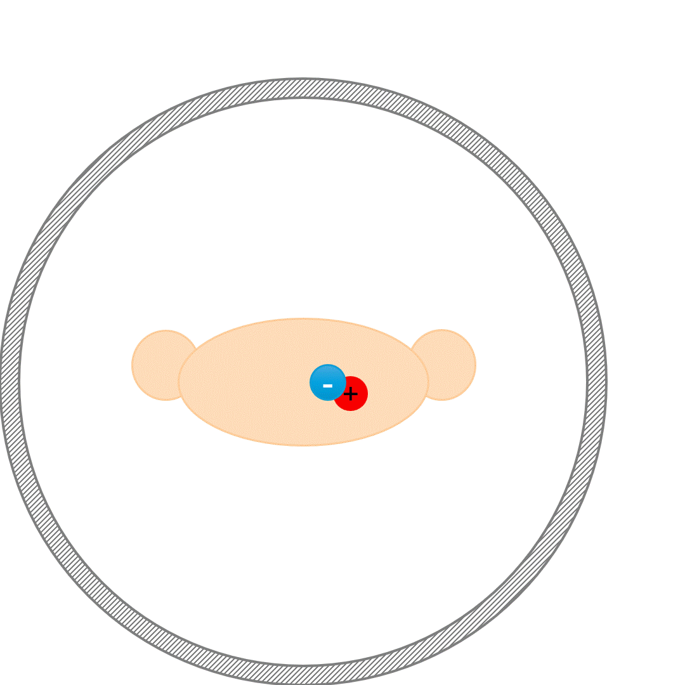
PET Attenuation and Scatter Correction (ASC)
Attenuation correction (AC) of annihilation photons along lines of response (LOR) in the patient body is another critical step
Scatter correction (SC) of Compton scattered photons, which can result in mis-allocation of the annihilated photons, is crucial
Notes:
True Coincidence
One annihilation
Straight path photons
Scatter Coincidence
One annihilation
Photons scatter
Artifactual measured LOR

Slide 4
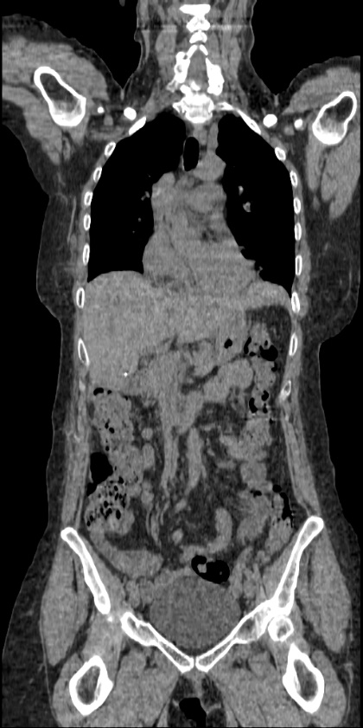
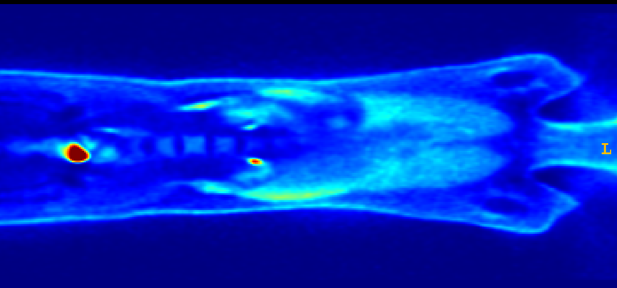
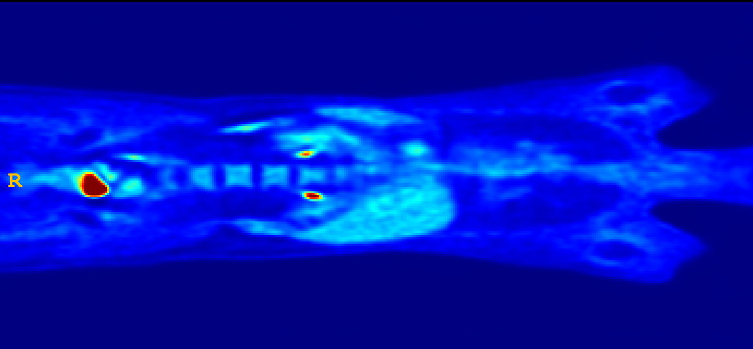
Effects of Attenuation Scatter Correction
Reduced mediastinal
uptake
'Hot' lungs
Non-uniform liver
Enhanced skin uptake
Non-Attenuation Corrected image (NAC) Attenuation-scatter corrected image(MAC) CT image
Notes:
MAC (Model-based Attenuation and Scatter Correction)

Slide 5
Data flow in a PET/CT scanner [1]
CT Image
X-ray acquisition
Anatomical (CT) Reconstruction
Smooth to PET Resolution
Translate CT to PET Energy (511 keV)
PET Image
PET Emission Acquisition
Attenuation/Scatter Correct PET Emission Data
Functional (PET) Reconstruction

Slide 6
Challenges in ASC using CT info
☢️Radiation Exposure
🚫Limited Availability
💰Cost and Complexity
💉Contrast Agent Issues
🩻 Artifacts

Slide 7
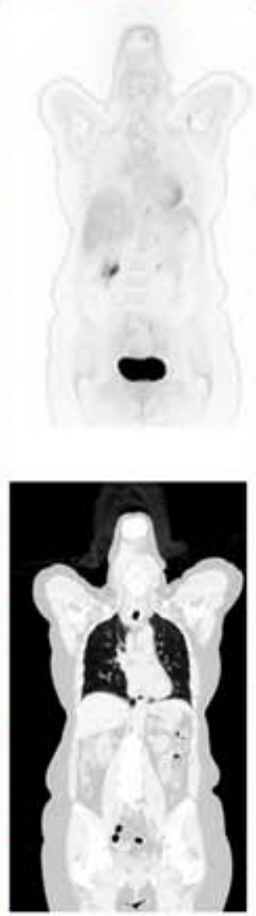
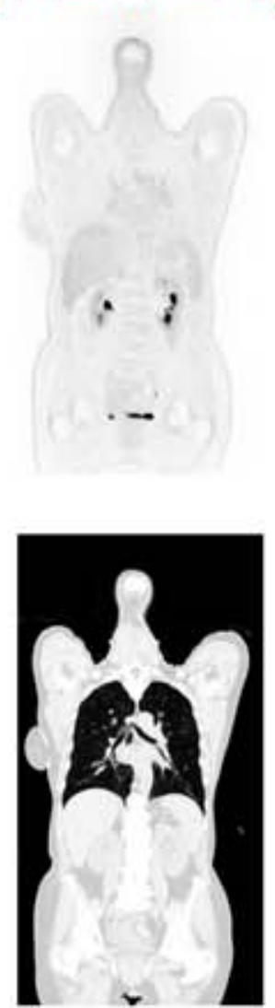
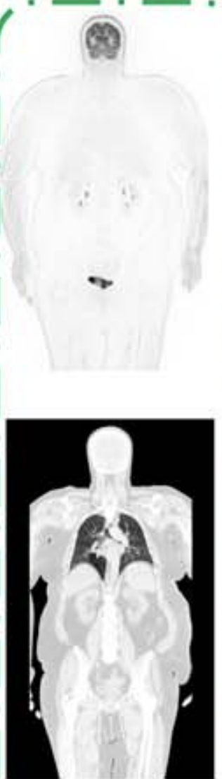
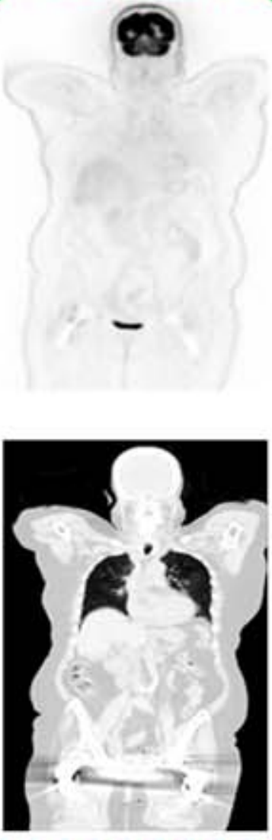
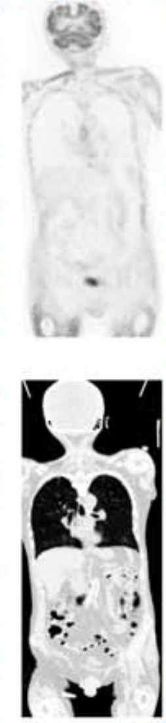
Challenges in ASC using CT info
Halo Motion Truncation Metal Mismatch
[4] Shiri, Clin Nucl Med. 2023

Slide 8
AI is starting to change medical imaging, for real
McMillan, PET Clinic, 2021

Slide 9
Research Objective
✔️ Address direct ASC of PET images without CT anatomical data
✔️ Create a universal model applicable to different radiotracers and scanners ✔️ Evaluate model performance in artifact removal across a multi-center dataset

Slide 10
Materials and Methods

Slide 11
Workflow of A CT-less deep learning network
PET raw data
Direct Method
CT images
Recon without AC & SC
Recon with AC & SC
Recon : reconstruction;
AC : attenuation correction,
SC : scatter correction,
NAC : non-corrected PET,
MAC : CT-Measured attenuation/scatter corrected,
DL PET : deep learning–corrected PET,
NAC (Input)
MAC (Target)
Model Training
DL PET
[2] Guo, Nat Commun. 2022
Notes:
A simple workflow of our work is : we used reconstructed pet images without applying any correction as input of a neural network. And we used a ct based corrected version of imput images as our target. From now on we named out imput nac and the target of the model or rather ground truth as mac.

Slide 12
Workflow of A CT-less deep learning network
PET raw data
Semi-Direct Method
CT images
Recon without AC & SC
Recon with AC & SC
NAC (Input)
ADCM (Target)
Anatomy-Dependent Correction Maps
Radiotracer-Dependent textures
Model Training
DL PET
[2] Guo, Nat Commun. 2022
Notes:
A simple workflow of our work is : we used reconstructed pet images without applying any correction as input of a neural network. And we used a ct based corrected version of imput images as our target. From now on we named out imput nac and the target of the model or rather ground truth as mac.

Slide 13
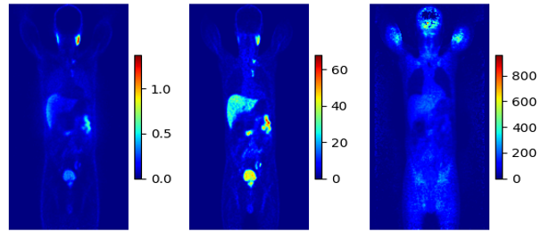
Sample of Input and Ground truths of the network
NAC MAC ADCM

Slide 14
⁶⁸Ga PET/CT Dataset [4]
Center | No | Train | Validation | Test | Scanner | Reconstruction | Matrix size × Z*
Center 1 | 56 | 43 | 11 | 2 | Siemens Biograph 6 | 3D-OSEM | 168 × 168
Center 2 | 31 | 25 | 4 | 2 | GE Discovery IQ | 3D-OSEM | 192 × 192
Center 3 | 45 | 35 | 8 | 2 | Siemens mCT | 3D-OSEM | 200 × 200
Center 4 | 40 | 28 | 10 | 2 | Siemens Biograph 6 | 3D-OSEM | 168 × 168
External Center | 12 | - | - | 12 | Siemens Horizon | PSF+TOF+3D-OSEM | 180 × 180
Total | 184 | 131 | 33 | 20 | - | - | -

Slide 15
¹⁸F-FDG Dataset [5]
Center | No | Train | Validation | Test | Scanner | Reconstruction | Matrix size × Z*
Center 6 | 55 | 39 | 6 | 11 | Siemens Biograph 6 | 3D-OSEM | 168 × 168
Center 7 | 43 | 23 | 9 | 10 | GE Discovery IQ | 3D-OSEM | 192 × 192
Total | 98 | 62 | 15 | 21 | - | - | -

Slide 16
Artifact dataset
190 patients ¹⁸Ga PSMA PET/CT Mostly Motion and Halo artifacts

Slide 17
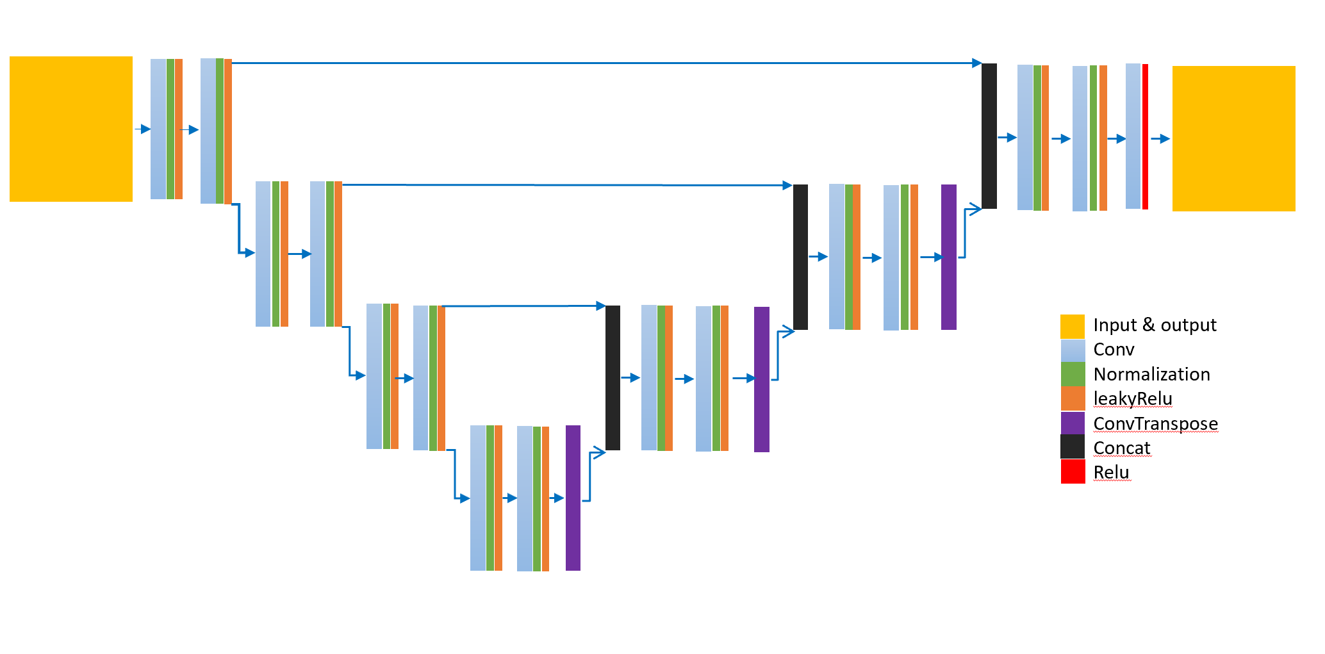
Hyper parameters
Dyn-UNet architecture
3D patches sized 168×168×16
20 patches per patient
Loss function of the mean squared error (MSE)
Learning rate of 0.001
Optimization Adam algorithm
Batch size: 4
spacing : [4.07, 4.07, 3.00]
four layers: [16, 32, 64, 128]
Kernels: [3, 3, 3]
2 super vision head
The architecture of DynUnet

Slide 18
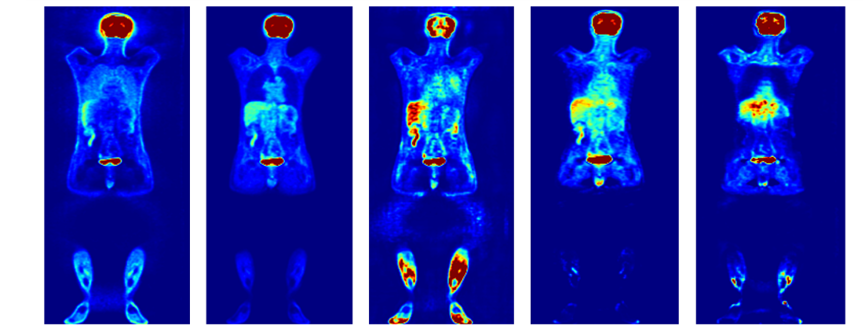
NAC MAC IMCM TL - MC ADCM
⁶⁸Ga-PET
IMCM
ADCM
¹⁸F-FDG
TL-MC
ADCM
IMCM → Integrated multi-Centre model ADCM → Anatomy-Dependent Correction Model TL-MC → Transfer Learning for IMCM model

Slide 19
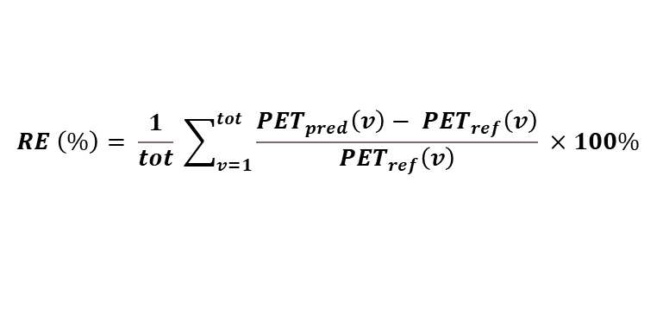
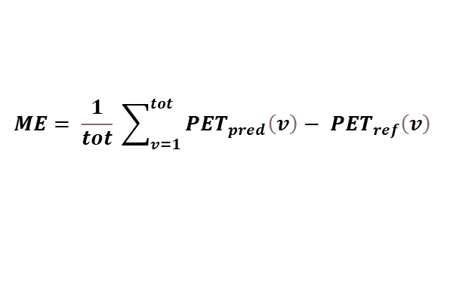
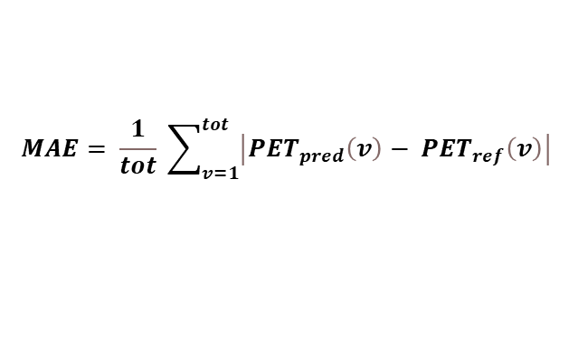
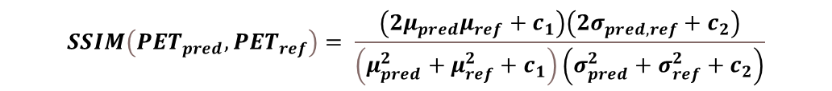
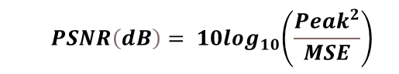
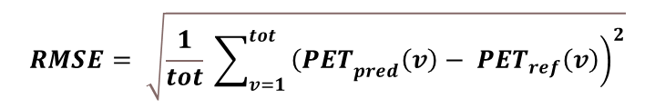
Quantification Metric
$$ME= \frac{1}{tot} \sum_{v=1}^{tot}{{PET}_{pred}\left(v\right)− {PET}_{ref}\left(v\right) }$$
$$MAE= \frac{1}{tot} \sum_{v=1}^{tot}{\left|{PET}_{pred}\left(v\right)− {PET}_{ref}\left(v\right)\right| }$$
$$RE \left(\%\right)= \frac{1}{tot} \sum_{v=1}^{tot}{\frac{{PET}_{pred}\left(v\right)− {PET}_{ref}\left(v\right)}{{PET}_{ref}\left(v\right)} ×100\% }$$
$$RMSE= \sqrt{\frac{1}{tot} \sum_{v=1}^{tot}{{\left.{\left(PET\right.}_{pred}\left(v\right)− {PET}_{ref}\left(v\right)\right)}^{2}}}$$
$${ PSNR\left(dB\right)= 10log}_{10}\left(\frac{{Peak}^{2}}{MSE}\right)$$
$$SSIM\left({PET}_{pred},{PET}_{ref}\right)= \frac{\left(2μ_{pred}μ_{ref}+c_{1}\right)\left(2σ_{pred,ref}+c_{2}\right)}{\left(μ_{pred}^{2}+μ_{ref}^{2}+c_{1}\right)\left(σ_{pred}^{2}+σ_{ref}^{2}+c_{2}\right)}$$

Slide 20
Results

Slide 21
⁶⁸Ga-PET

Slide 22
⁶⁸Ga-PET

Slide 23
¹⁸F-FDG
Notes:
For ME, ADCM shows overestimated and TLMC shows understination,
For RE, RMSE TLMC shows lower values.
About PSNR and SSI, ADCM shows more stability and constant parameters regarding TL-MC.

Slide 24
¹⁸F-FDG

Slide 25
Case Study on artifact images

Slide 26
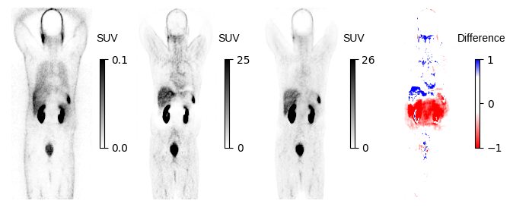
Halo artifact in kidney

Slide 27
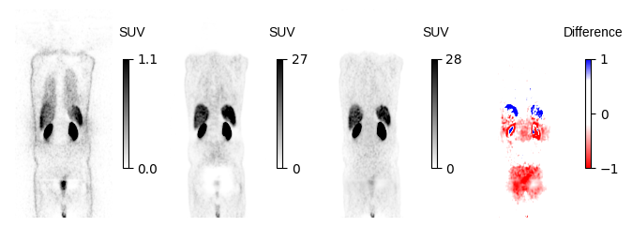
Halo artifact

Slide 28
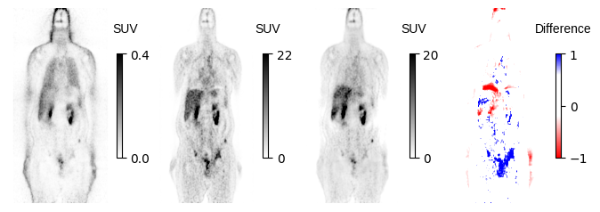
Motion Artifact

Slide 29
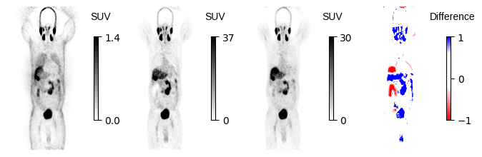
Motion & Halo Artifact

Slide 30
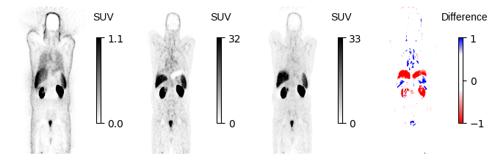
Motion artifact

Slide 31
Discussion

Slide 32
Discussion
🗨️ Developed a CT-free DL models for ASC in PET imaging,
🗨️ Tested across different centers and radiotracers.
🗨️ In Face of cross-center data, IMCM outperformed ADCM, in MEA, RE, RMSE and SSI.
Regarding cross-tracer data
Notes:
🗨️ Developed a CT-free DL models for ASC in PET imaging, tested across different centers and radiotracers.
🗨️ IMCM outperformed ADCM, demonstrated more reliable and consistent performance in SUV estimations.
🗨️ IMCM showed significant improvement in quantitative accuracy and artifact correction.
🗨️ Using large, heterogeneous datasets enhances the generalizability and applicability of ASC models in PET imaging. These diverse datasets ensure the model performs well on unseen data, making it robust and reliable for real-world clinical settings.

Slide 33
Limitations

Slide 34
Limitations
🧱 Single universal models may not be effective; radioisotope-specific tuning is necessary.
🧱 Limited access to computational resources caused time consuming each training loop.
Notes:
🧱 Models optimized for one radiotracer type may not perform well with others, necessitating tracer-specific tuning.
🧱 Single universal models may not be effective; radioisotope-specific tuning is necessary.
🧱 Limited access to computational servers caused each training loop to take excessive time.

Slide 35
Future Work

Slide 36
Future Work
📍 Train and test the model on more data from other centers.
📍 Assess the model organ-wise.
📍 Explore more Clinical Imaging Parameters.
📍 Targeted analysis for artifactual images.
📍 Rigorous statistical testing of categorized outcomes.
📍 Investigate other Neural Networks.
📍 Explore more other hyper-parameters.
Notes:
📍 Train and test the model on more data from other centers.
📍 Assess the model organ-wise.
📍 Explore more Clinical Imaging Parameters: SUVmean, SUVmax, and total lesion metabolism.
📍 Targeted analysis for artifactual images.
📍 Rigorous statistical testing of categorized outcomes.
📍 Investigate Alternative Neural Networks generative adversarial networks (GANs), variational autoencoders, transformer-based models like Swin-UNet.
📍 Experiment with other optimizers like AdamW, RMSprop, and Nadam.

Slide 37
Conclusion

Slide 38
Conclusion
🔍 Designed a network to directly performs ASC from raw data.
This approach is less vulnerable to the challenges of pseudo-CT synthesis.
🔍 Preformed well in different centers.
making it reliable and flexible for use in clinics.
🔍 Addressed the artifact challenges.
high capability in detecting and removing artifacts in PET scans.
🔍 Constructed an assurance method
to not only detect but to also overcome those artifacts.
🔍 Be applicable where only Stand-alone PET
or PET/MRI systems are available.
🔍 Reduced in the cumulative radiation dose
would be valuable, particularly the paediatrics population
Notes:
🔍 Designed a network to directly performs ASC from raw data. This approach is less vulnerable to the challenges of pseudo-CT synthesis.
🔍 Preformed well in different centers, making it reliable and flexible for use in clinics.
🔍 Addressed the artifact challenges, high capability in detecting and removing artifacts in PET scans.
🔍 Constructed and validated a highly effective and fast quality assurance method to not only detect but to also overcome those artifacts.
🔍 Be applicable where only Stand-alone PET or PET/MRI systems are available.

Slide 39
References
[4] Shiri I, Salimi Y, Hervier E, Pezzoni A, Sanaat A, Mostafaei S, et al. Artificial Intelligence-Driven Single-Shot PET Image Artifact Detection and Disentanglement: Toward Routine Clinical Image Quality Assurance. Clin Nucl Med. 2023 Dec 1;48(12):1035–46
[1] Schmitz et al. The physics of PET/Ct scanners. PET and PET/CT: a clinical guide, 2005. [2] Chen, X., Liu, C. Deep-learning-based methods of attenuation correction for SPECT and PET. J. Nucl. Cardiol. 30, 1859–1878 (2023). [3] Guo R, Xue S, Hu J, Sari H, Mingels C, Zeimpekis K, et al. Using domain knowledge for robust and generalizable deep learning-based CT-free PET attenuation and scatter correction. Nat Commun. 2022 Dec 1;13(1). [5] Shiri I, Salimi Y, Hervier E, Pezzoni A, Sanaat A, Mostafaei S, et al. Artificial Intelligence-Driven Single-Shot PET Image Artifact Detection and Disentanglement: Toward Routine Clinical Image Quality Assurance. Clin Nucl Med. 2023 Dec 1;48(12):1035–46.

Slide 40


Slide 41
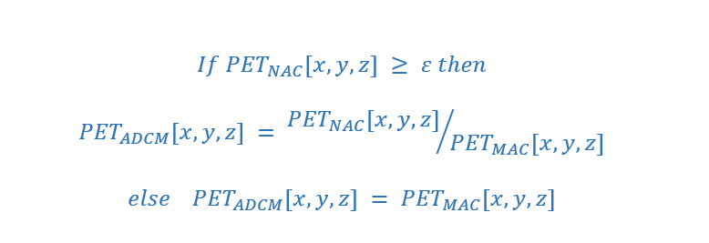
Workflow of Decomposition-Based Approach [1]
NAC (Input)
MAC (Target)
Anatomy-Dependent Correction Maps (ADCM)
Model Training
Anatomy-independent textures
DL PET
[2] Guo, Nat Commun. 2022

Slide 42
Workflow of Decomposition-Based Approach [1]
NAC (Input)
ADCM
Anatomy-Dependent Correction Maps (ADCM)
Model Training
Anatomy-independent textures
DL PET
[2] Guo, Nat Commun. 2022

Slide 43
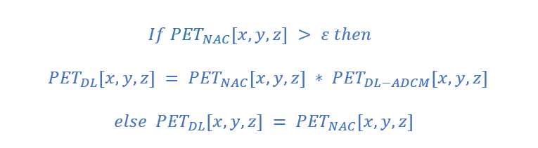
Workflow of Decomposition-Based Approach [1]
NAC (Input)
ADCM
Model Training
DL ADCM
DL PET
[2] Guo, Nat Commun. 2022

Slide 44
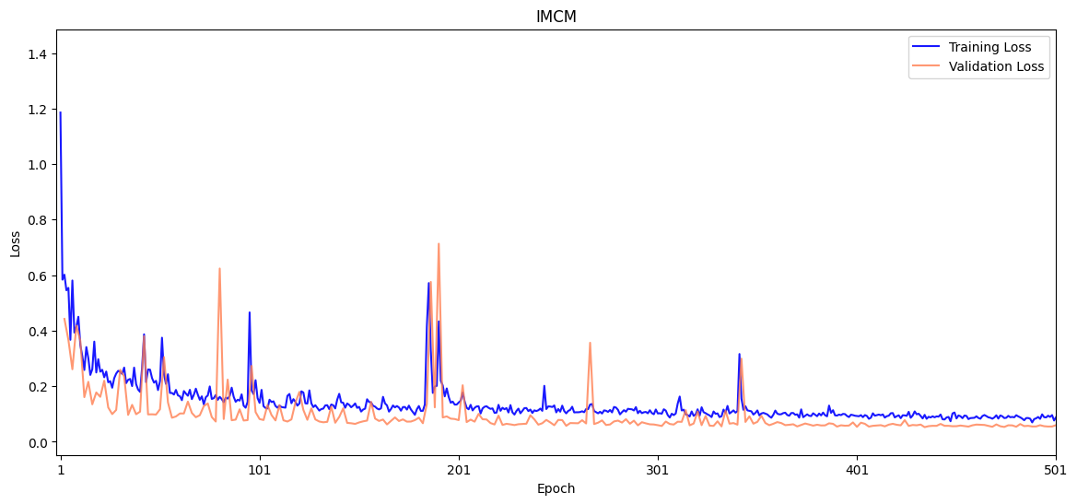
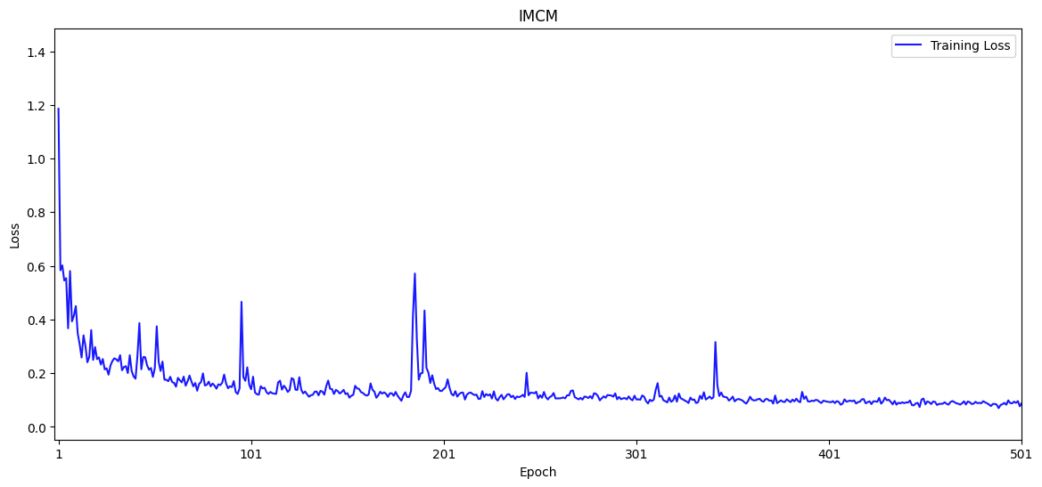
⁶⁸Ga-PET
Integrated multi-Centre model (IMCM): the best metric of 0.0527 at epoch 434.

Slide 45
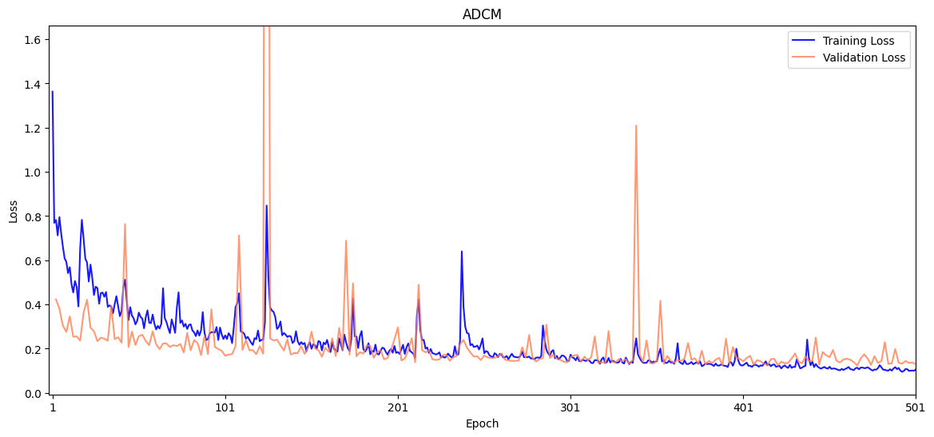
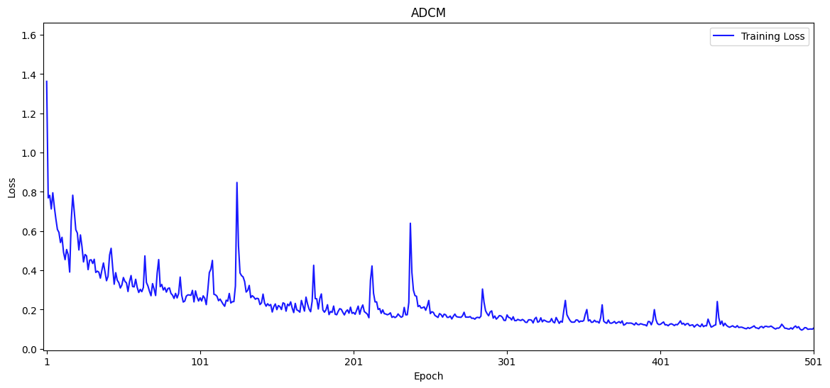
⁶⁸Ga-PET
Anatomy-Dependent Correction Model (ADCM): the best metric of 0.1237 was reached at epoch 466.

Slide 46
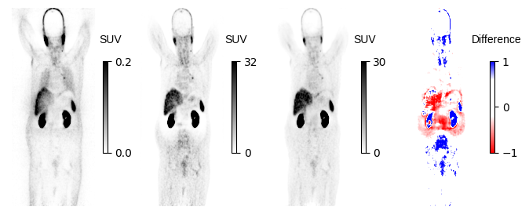
Motion and Halo

Slide 47
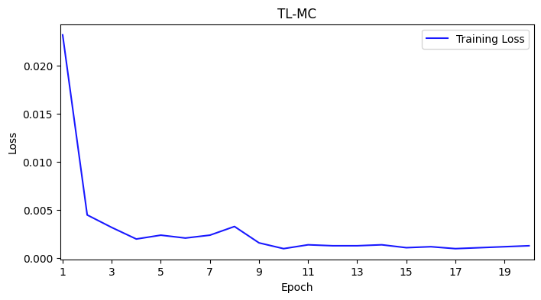
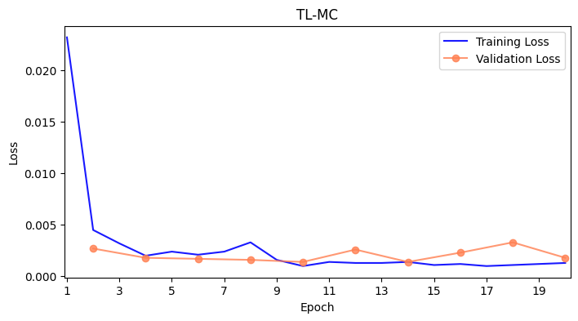
¹⁸F-FDG
Transfer Learning for IMCM model (TL-MC):

Slide 48
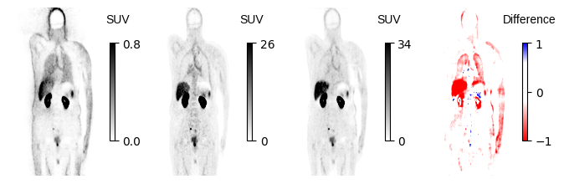
Truncation and Motion

Slide 49
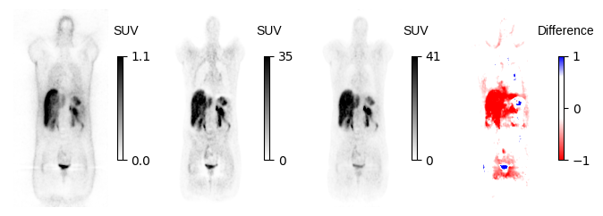
Halo

Slide 50
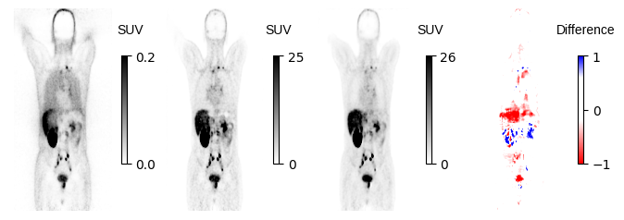
Motion Artifact

Slide 51
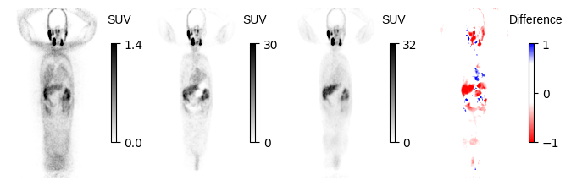
Metal artifact

Slide 52
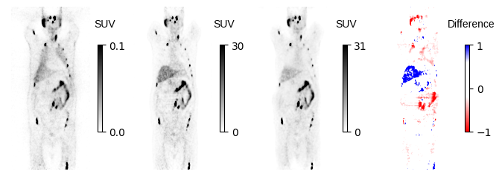
Motion Artifact???

Slide 53
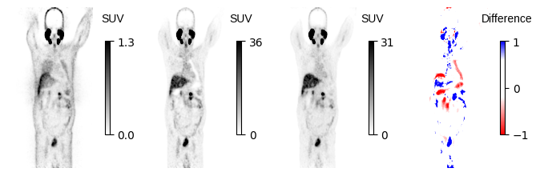
???

Slide 54



